Slide 1

PRESENTATION
on E- Commerce( Online Shopping) Website
“AnyBuy”
( A fully Responsive E-commerce Website)
TEAM MEMBERS :-
SHREYANSH NIGAM
GUIDE :-
PROJECT COORDINATOR :-

Slide 2

Project :-
“AnyBuy”
( A fully Responsive E-commerce Website)

Slide 3

PROBLEM STATEMENT
In today’s fast-changing business environment, it’s extremely important to be able to respond
to client needs in the most effective and timely manner. If your customers wish to see your business online and have instant access to your products or services.

Slide 4

SOLUTION
“E-Commerce Website for Online Shopping”
First of all, What is E-commerce?
Commonly known as Electronic Marketing.
“It consist of buying and selling goods and services over an electronic systems Such as the internet and other computer networks.”
E-commerce is fast gaining ground as an accepted and used business paradigm. More and more business houses are implementing web sites providing functionality for performing commercial transactions over the web.
It is reasonable to say that the process of shopping on the web is becoming commonplace.
Companies like, Flipkart, Amazon, Myntra, etc. are some of the big names of this field.

Slide 5

objective
The objective of this project is to develop a general purpose e-commerce store where product like clothes can be bought from the comfort of home through the Internet.
An online store is a virtual store on the Internet where customers can browse the catalog and select products of interest. The selected items may be collected in a shopping cart. At checkout time, the items in the shopping cart will be presented as an order. At that time, more information will be needed to complete the transaction. Usually, the customer will be asked to fill or select a billing address, a shipping address, a shipping option, and payment information such as credit card number.

Slide 6

Abstract
In today’s fast-changing business environment, it’s extremely important to be able to respond to client needs in the most effective and timely manner. If your customers wish to see your business online and have instant access to your products or services.
AnyBuy is an online retail e-commerce web application, which retails various products like, electronics, lifestyle, etc. This project allows viewing various products available, enables registered users to purchase desired products instantly using payment gateways and also can place order by using Cash on Delivery (Pay Later) option.
This project provides an easy access to Administrators and Managers to view orders placed and manage their consumer needs.
In order to develop an e-commerce website, a number of Technologies must be studied and understood. These include multi-tiered architecture, server and client side scripting techniques, implementation technologies such as REST API, programming language (such as Python for django) and relational databases (SQLlite). This is a project with the objective to develop a basic website where a consumer is provided with a shopping cart application and also to know about the technologies used to develop such an application.

Slide 7

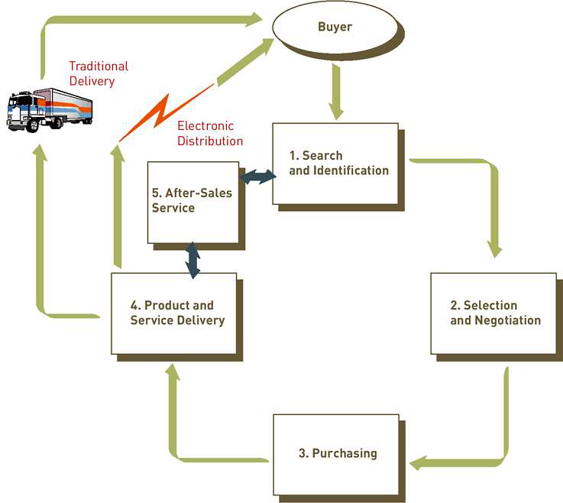
PROCESS OF E- COMMERCE

Slide 8
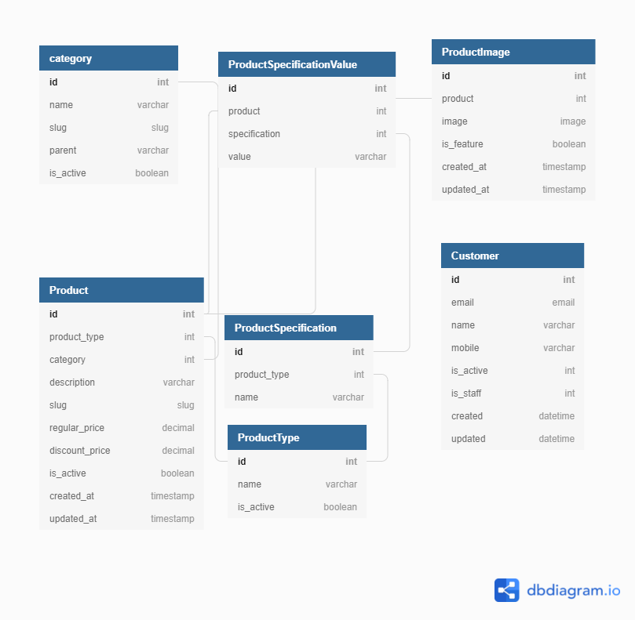
DATA FLOW DIAGRAM

Slide 9
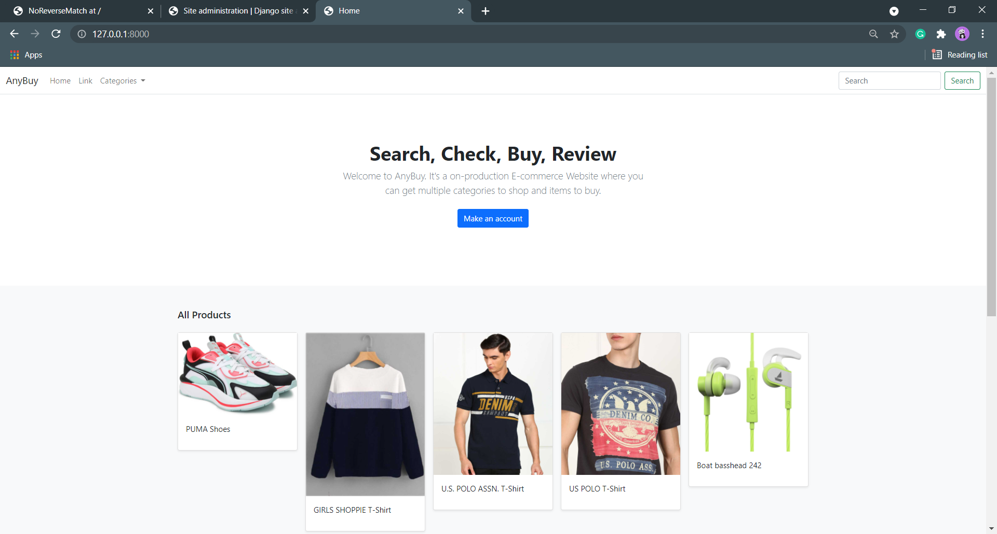
HOME PAGE

Slide 10
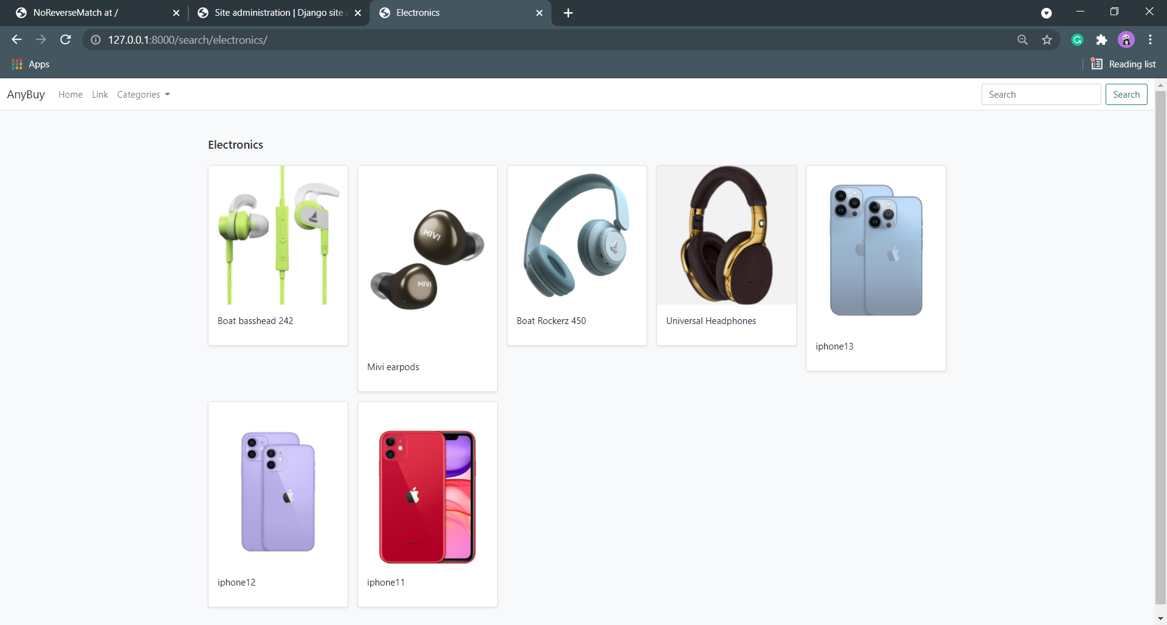
Electronics Category

Slide 11
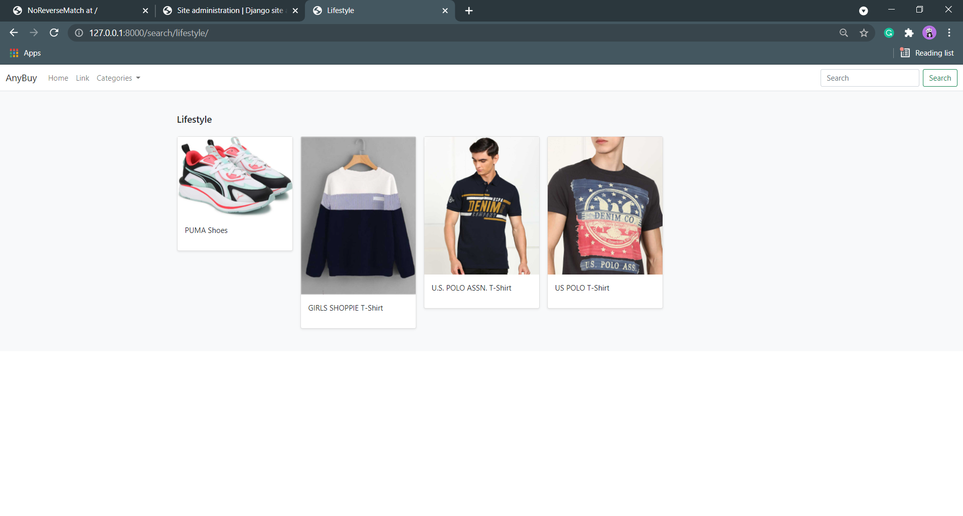
Lifestyle Category

Slide 12
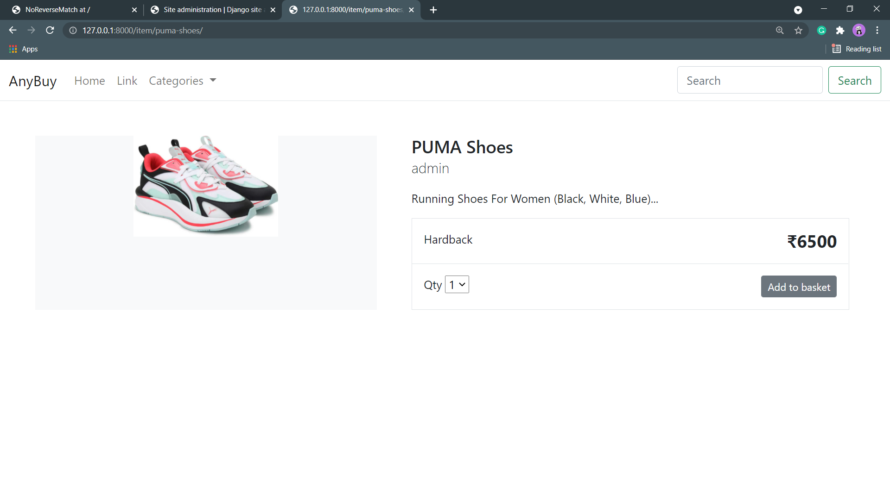
Example of product in Lifestyle Category

Slide 13
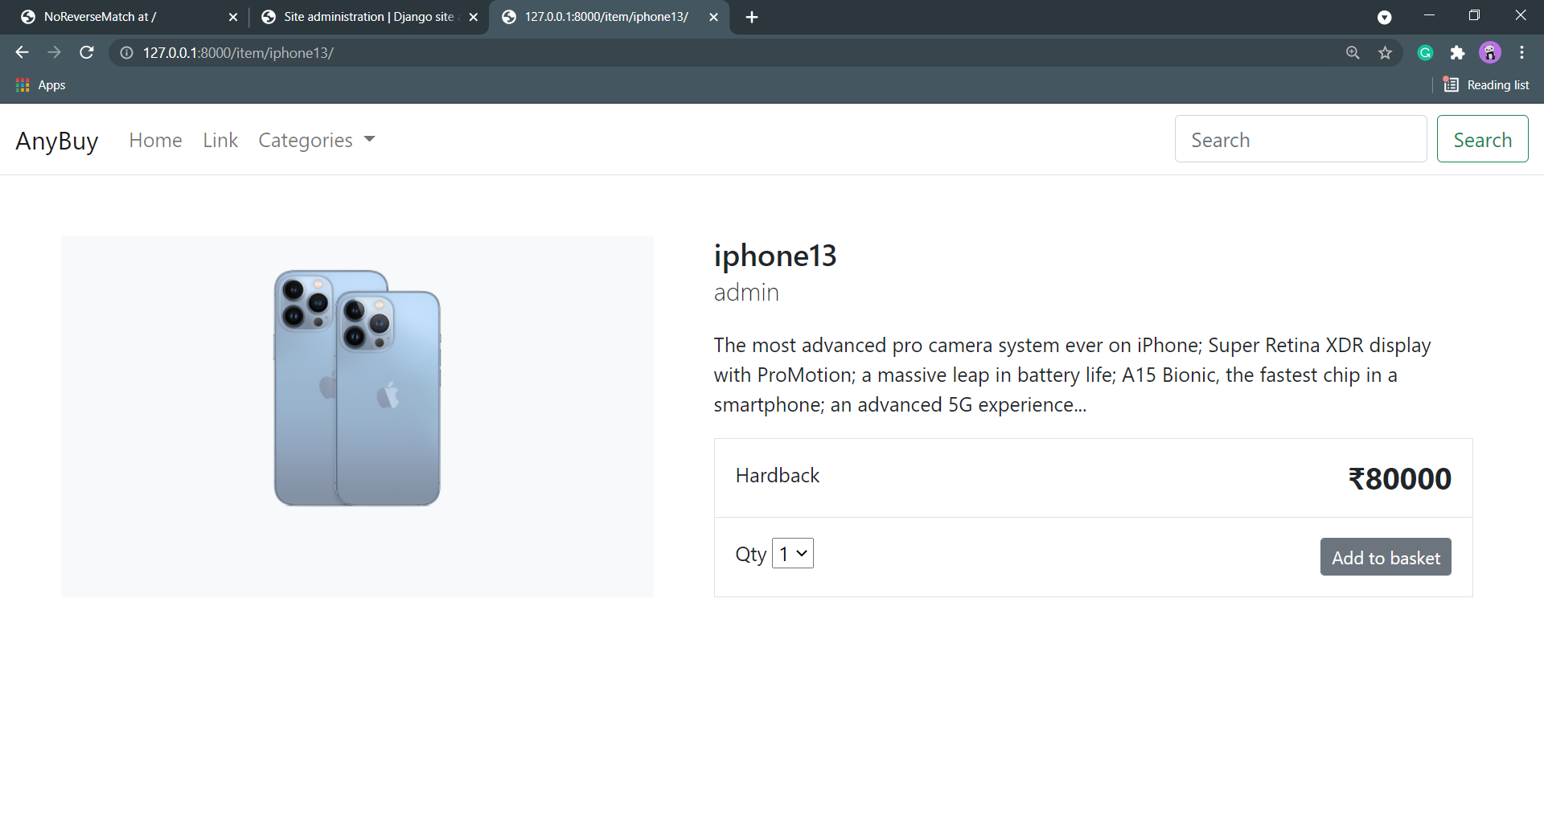
Example of Product in Electronics Category

Slide 14

FUTURE PLANS
We are thinking of some modifications and adding some advanced new features in out system. Some of them are –
GUI modification (more user friendly)
Users can sell their products
Users can signup / login using their social media Account such as facebook , google+ etc.
AI CHATBOT (for queries and services)

Slide 15
THANK YOU!

